Slide 1
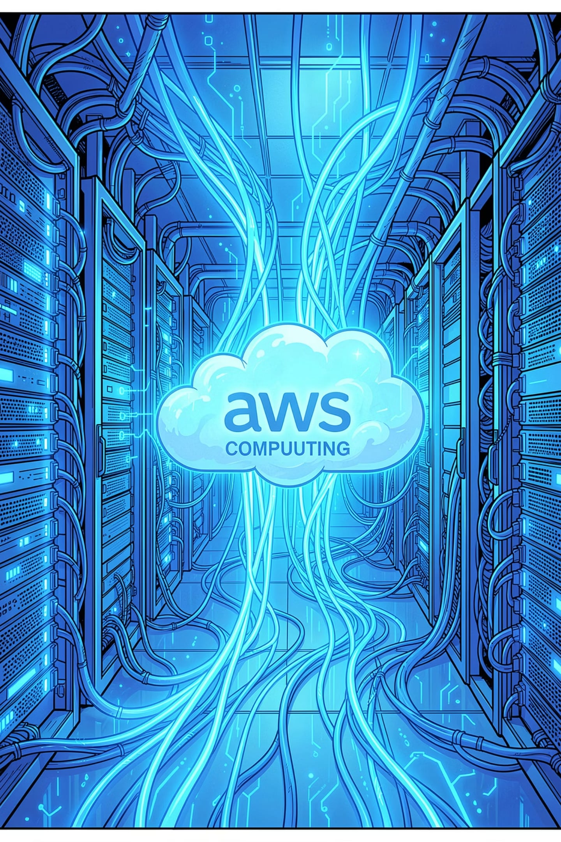
Static Website Hosting
AWS Lambda · API Gateway · CloudWatch · CloudTrail
AWS Internship Project
Adarsh Tripathi · [Shri Ramswaroop Memorial College of Engineering and Management] · [13-07-2026]
Faculty- Anmol Kamboj
Notes:
Welcome slide. Introduce yourself and the project scope. This internship project demonstrates serverless static website hosting using core AWS services — Lambda for compute, API Gateway for the HTTP interface, CloudWatch for monitoring, and CloudTrail for audit logging. The goal is to show how a fully functional webpage can be served without traditional infrastructure.

Slide 2




CORE SERVICES
Project Overview
Host a static HTML page serverlessly — compute, routing, monitoring, and auditing via four AWS services.
AWS Lambda
API Gateway
Serverless compute — runs code without provisioning servers
Manages HTTP requests and routes them to Lambda
CloudWatch
CloudTrail
Monitors logs, metrics, and execution events
Audits API activity across your AWS account
Notes:
Explain each service briefly. Lambda is the compute layer — it executes your code. API Gateway is the front door that accepts HTTP requests. CloudWatch captures logs and metrics so you can see what happened. CloudTrail records every API call for compliance and auditing. Together, they form a complete serverless hosting and monitoring stack.

Slide 3
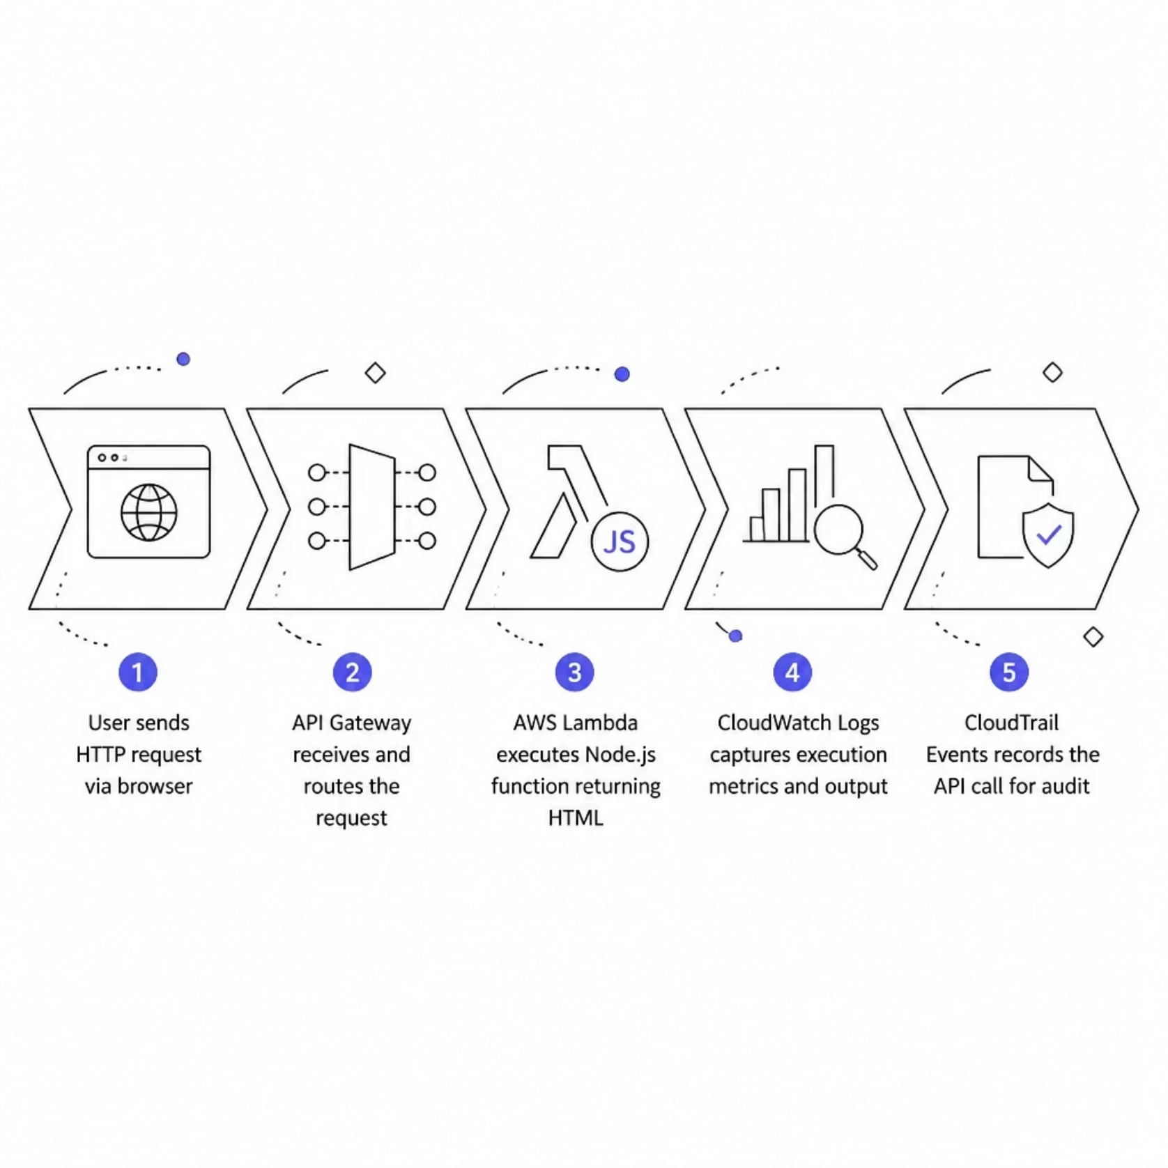
ARCHITECTURE
System Architecture & Request Flow
How It Works
User — Browser sends HTTP request to Invoke URL
API Gateway — Routes request to Lambda function
Lambda — Executes Node.js code, returns HTML response
CloudWatch — Logs execution output and metrics
CloudTrail — Audits all API activity for compliance
Notes:
Walk through the request flow step by step. The user opens the Invoke URL in their browser. API Gateway receives that HTTP request and triggers the Lambda function. Lambda runs the Node.js code which returns the HTML response. CloudWatch automatically captures the execution logs. CloudTrail independently records the API call for audit purposes. Emphasize that this is fully serverless — no EC2 instances, no load balancers.

Slide 4
IMPLEMENTATION
Step-by-Step Implementation
01
02
Create Lambda Function
Add HTML in index.mjs
myFirstLambdaFunction · Node.js runtime
Embed static HTML in handler code
03
04
Deploy & Test
Verify Monitoring
Deploy function · Create test event · Execute successfully
Check CloudWatch logs · Confirm CloudTrail events
05
06
Add API Gateway Trigger
Launch in Browser
Configure trigger · Generate Invoke URL
Open URL · Static HTML page displayed
Notes:
Walk through each implementation step in order. First, create the Lambda function named myFirstLambdaFunction using Node.js runtime. Add your HTML code directly inside the index.mjs handler file. Deploy the function, then create a test event in the Lambda console and execute it — you should see a successful response. Next, verify CloudWatch logs show the execution output and check CloudTrail for the recorded API events. Then add the API Gateway trigger to expose an HTTP endpoint, generate the Invoke URL, and finally open that URL in your browser to see the static HTML page rendered live.

Slide 5

RESULTS
Results & Monitoring Verification
✅ Lambda Execution
Function returned 200 OK with HTML body
📊 CloudWatch Logs
Execution timestamps, output, and metrics captured
🔍 CloudTrail Events
All API calls logged and auditable
🌐 Browser Output
Invoke URL rendered static HTML page successfully
Notes:
Show the results of each verification step. The Lambda function executed successfully and returned a 200 OK response with the HTML body. CloudWatch logs captured the execution timestamps, function output, and performance metrics. CloudTrail recorded every API call made during the process for full auditability. Finally, opening the Invoke URL in the browser displayed the static HTML webpage as expected. This confirms the entire pipeline — from API Gateway through Lambda to monitoring — is working end to end.

Slide 6





CONCLUSION
Advantages & Key Takeaways
Serverless
Cost-Effective
No server provisioning or management
Pay only per execution
Auto Scaling
Secure & Compliant
Handles traffic spikes automatically
Built-in IAM controls and audit trails
✅ Static HTML page hosted successfully via Lambda + API Gateway. Execution verified in CloudWatch. Activities audited in CloudTrail.
Notes:
Summarize the key advantages of this architecture. Serverless means zero server management. Cost-effective because you only pay when the function executes. Auto scaling handles any traffic volume without configuration. Security is built in through IAM roles and policies. CloudTrail provides full compliance auditing. Conclude by reaffirming that the project successfully demonstrated a complete serverless static hosting solution with full monitoring and audit capabilities — a strong foundation for real-world AWS deployments.

